Slide 1
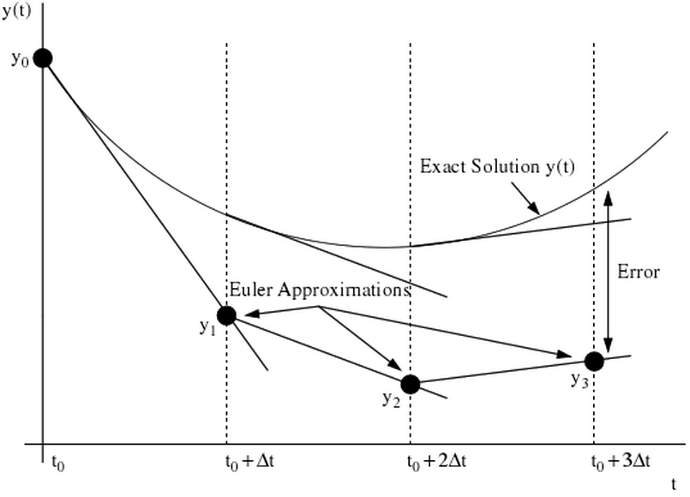
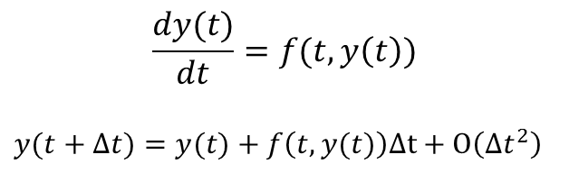
Euler Method
$$\frac{dy(t)}{dt}=f(t,y\left(t\right))$$
$y(t+Δt)=y(t)+f\left(t,y(t)\right)Δt+O\left(Δt^{2}\right)$
Figure 1. Graphical description of the Euler method (Kutz, 2013)

Slide 2
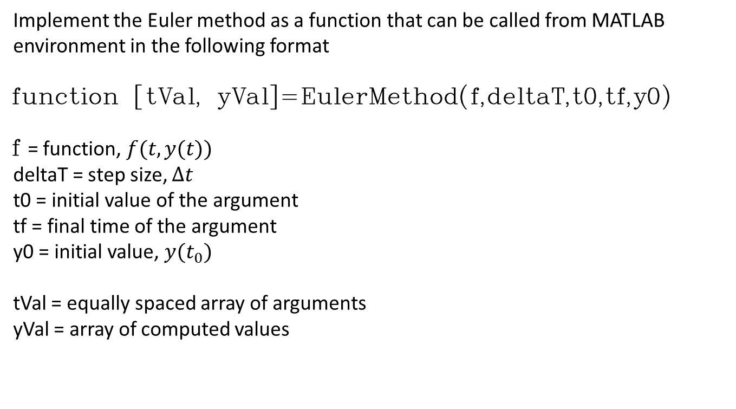
Implement the Euler method as a function that can be called from MATLAB
environment in the following format
function [tVal, yVal]=EulerMethod(f,deltaT,t0,tf,y0)
f = function, $f(t,y(t))$
deltaT = step size, $Δt$
t0 = initial value of the argument
tf = final time of the argument
y0 = initial value, $y(t_{0})$
tVal = equally spaced array of arguments
yVal = array of computed values

Slide 3
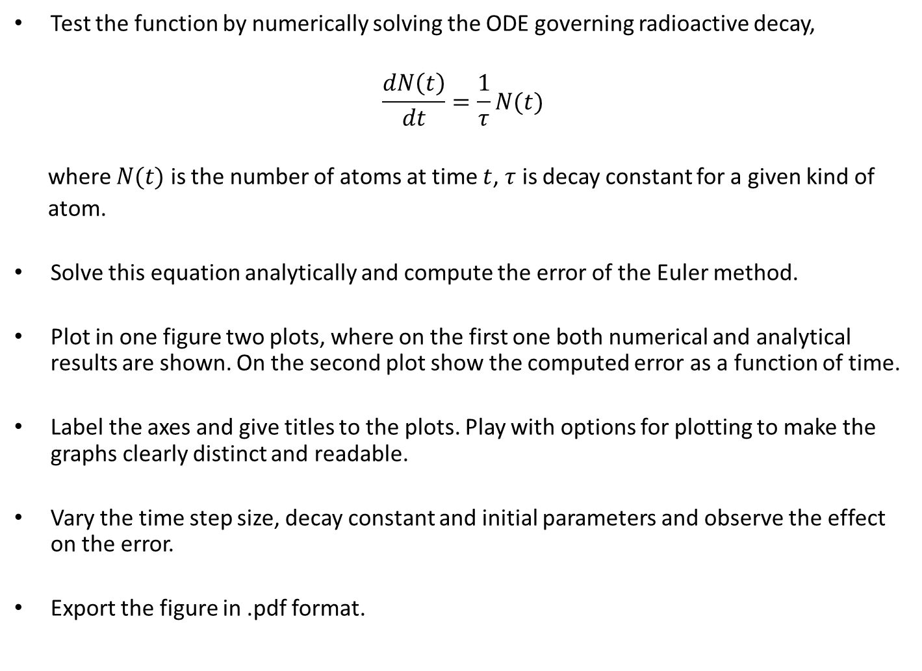
Test the function by numerically solving the ODE governing radioactive decay,
$$\frac{dN\left(t\right)}{dt}=\frac{1}{τ}N(t)$$
where $N(t)$ is the number of atoms at time $t$, $τ$ is decay constant for a given kind of
atom.
Solve this equation analytically and compute the error of the Euler method.
Plot in one figure two plots, where on the first one both numerical and analytical results are shown. On the second plot show the computed error as a function of time.
Label the axes and give titles to the plots. Play with options for plotting to make the graphs clearly distinct and readable.
Vary the time step size, decay constant and initial parameters and observe the effect on the error.
Export the figure in .pdf format.

Slide 4
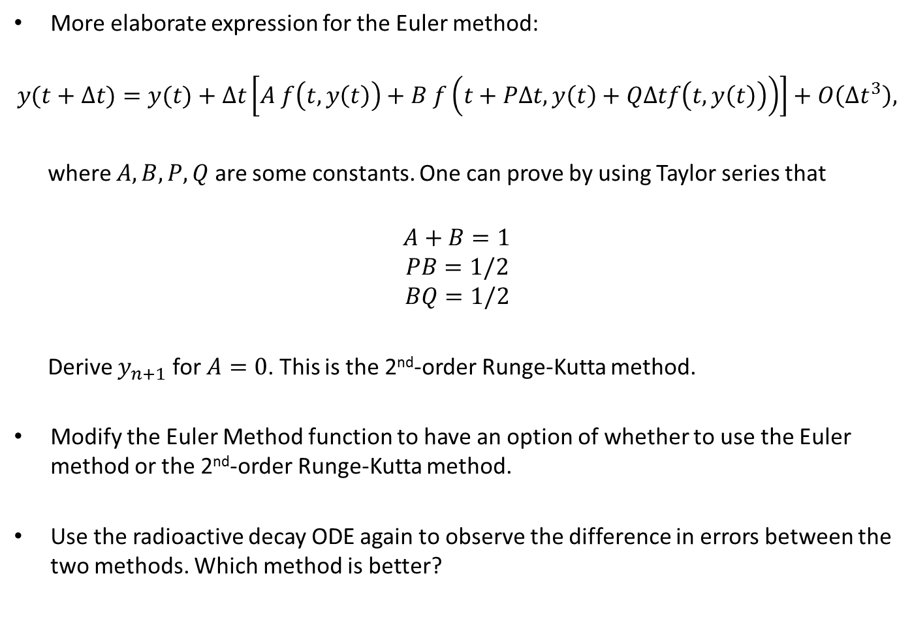
More elaborate expression for the Euler method:
$$y(t+Δt)=y(t)+Δt\left[A f\left(t,y\left(t\right)\right)+B f\left(t+PΔt, y\left(t\right)+QΔtf\left(t,y\left(t\right)\right)\right)\right]+O\left(Δt^{3}\right),$$
where $A, B, P, Q$ are some constants. One can prove by using Taylor series that
$$A+B=1$$
$$PB=1/2$$
$$BQ=1/2$$
Derive $y_{n+1}$ for $A=0$. This is the 2nd-order Runge-Kutta method.
Modify the Euler Method function to have an option of whether to use the Euler method or the 2nd-order Runge-Kutta method.
Use the radioactive decay ODE again to observe the difference in errors between the two methods. Which method is better?

